Slide 1
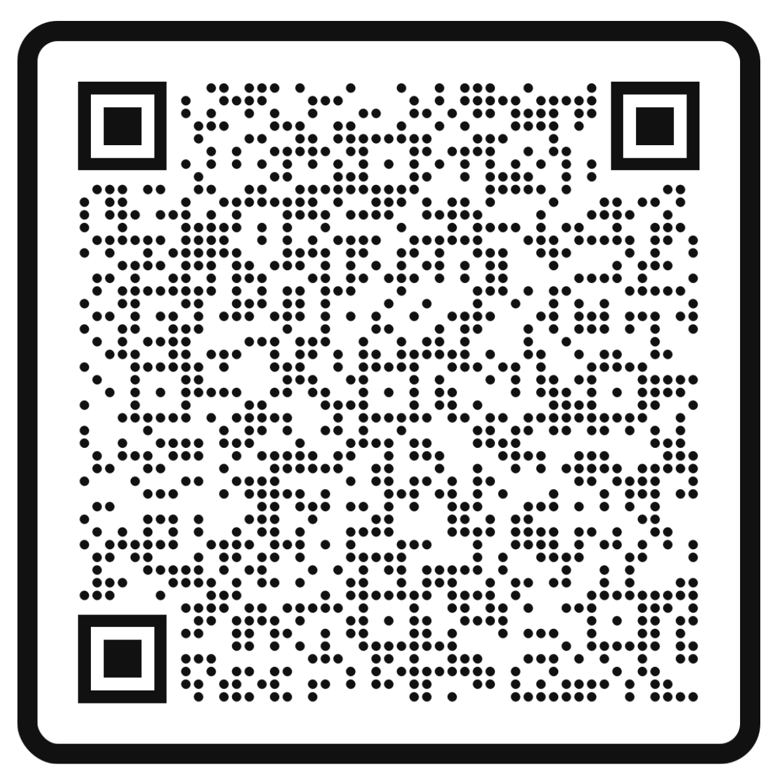
Complete our Collaboration Survey by September 15th!
How well we work together makes a difference. It’s our ability to work together that helps us accomplish our goals and improve our community.
If something is important, then it should be measured and monitored. Help us see how we’re doing working with one another by completing this survey.

Slide 2
Wayne County Partnership Meeting
Wayne-FingerLakes BOCES | August 2nd, 2023

Slide 3
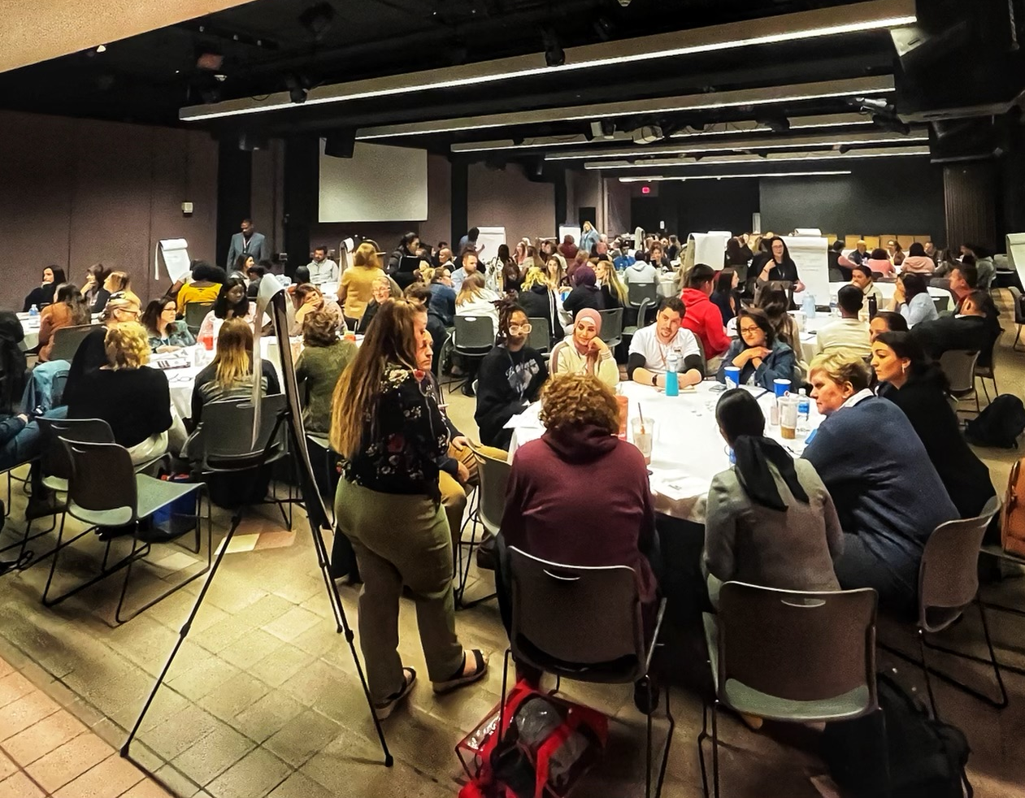
Meeting Agenda
Welcome and Introduction
Partnership Updates
Food Distribution and Basic Needs
Career Carnival Recruitment
Health and Wellness Updates
211 Resource Mapping and MyWayfinder
Data Discussion
Share Outs
Important Dates

Slide 4
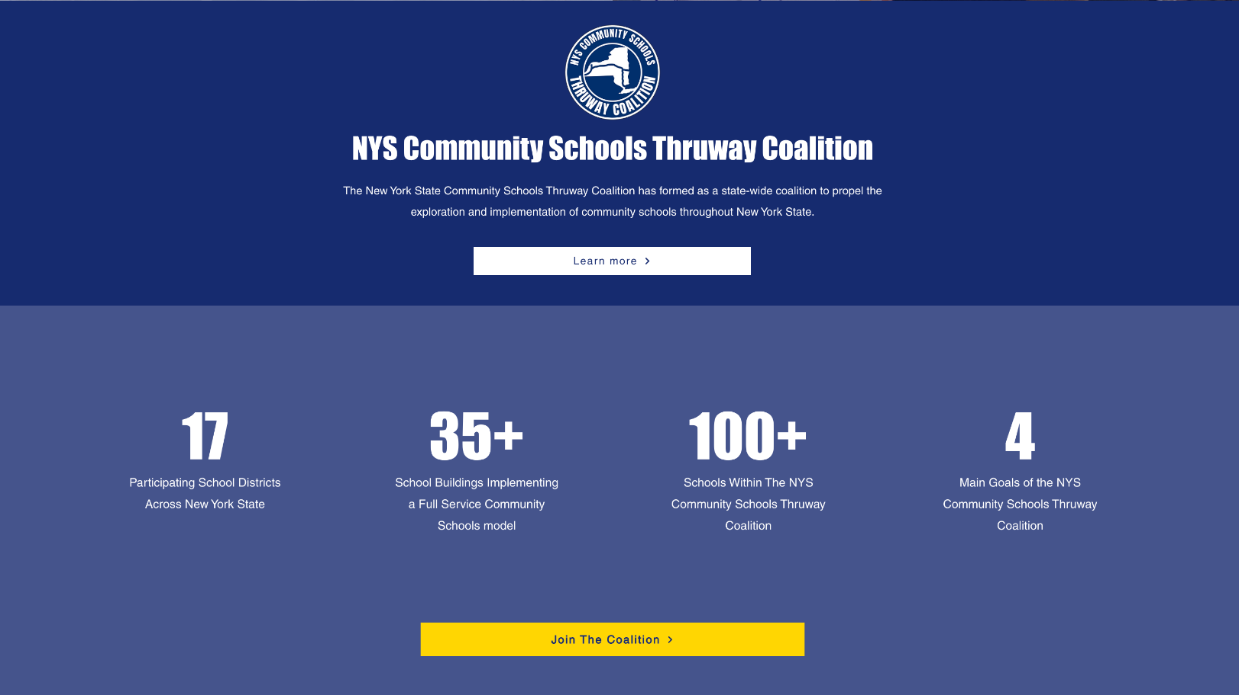

Slide 5
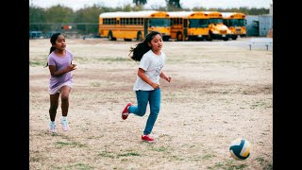
Making An Impact - Kern County California

Slide 6
Welcome Wallace Foundation!

Slide 7
Meeting Agenda
Welcome and Introduction
Partnership Updates
Food Distribution and Basic Needs
Career Carnival Recruitment
Health and Wellness Updates
211 Resource Mapping and MyWayfinder
Data Discussion
Share Outs
Important Dates

Slide 8
Partnership Updates
Welcome New Co-Chair
Systems of Care
Food Distribution
Career Carnival
National Center for Community Schools
FLX Community Schools Summer Symposium

Slide 9
Welcome New Co-Chair, Ed Hunt!
Ed started his career as a case manager in the Rochester area in the mid-1980s, often serving the deaf community. Over the years, he advanced into administration at Rochester Rehabilitation Center, where he worked for nearly 15 years. He moved on to the Wayne County Mental Health Department in 2007 in his role as Deputy Director. He has been a direct part of growing the agency with the goal of meeting the needs of individuals and families residing in the county. His work has included the direct involvement in the expansion of the school-based satellite clinics into every school district in the county as well as the Williamson BOCES and the FLCC Newark campus, the attainment of a $4 million dollar federal expansion grant through Substance Abuse and Mental Health Services Administration (SAMHSA), along with numerous other state-level grants. He was appointed by our State Senator, Pamela Helming, to sit on her Children’s Mental Health Services taskforce, he was involved in the development of the 60 unit Lakeview apartment project in Macedon, known as Woodland Commons. He has been directly involved in countless other achievements at local, regional and state levels. In addition to his role as the deputy director of the county mental health department, he has also served Wayne County as the county compliance officer since 2019.

Slide 10
SYSTEMS OF CARE
NYS OMH and Wayne County Dpt of Behavioral Health
Ongoing effort to create a continuum of care

Slide 11
Food Distributions & Basic Needs
August 2023
Wednesday, August 9th – Wayne County Partnership & Foodlink Food Distribution 10 AM until food is gone! Shady Brooke Plaza, 4500 NYS Route 414, Rose
Friday, August 11th – Wayne County Partnership & Foodlink Food Distribution 10 AM until food is gone! Huron Town Barns, 10880 Lummisville Rd, Huron
Wednesday, August 16th – Wayne County Partnership & Foodlink Food Distribution 10 AM until food is gone! W-FL BOCES Conference Center, 131 Drumlin Court, Newark
Tuesday, August 29th – Wayne County Partnership & Foodlink Food Distribution 10 AM until food is gone! Red Creek Jr./Sr. High School, 6574 South St, Red Creek

Slide 12
Career Carnival Recruitment

Slide 13
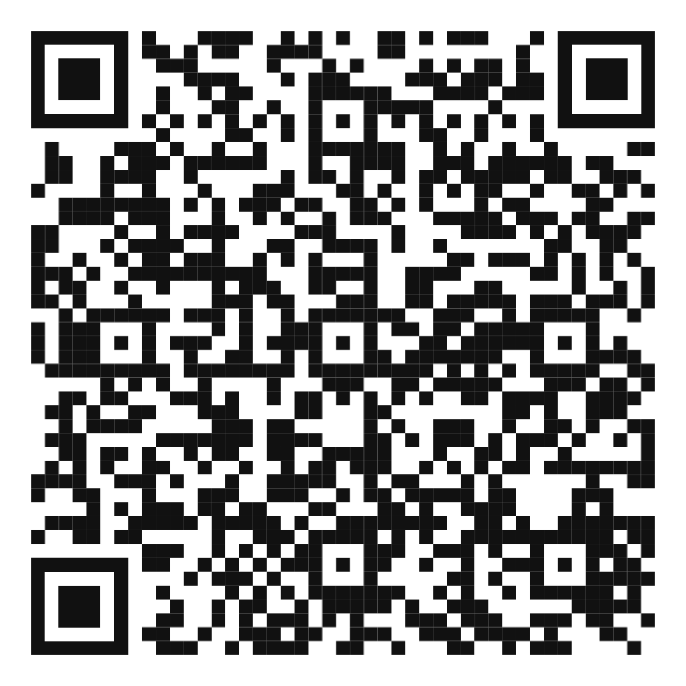
Lisa Hackett - National Center
August 9th and 10th at The Conference Center at Wayne-Finger Lakes BOCES
Community Schools 101 Sessions will be offered by Deputy Director of Community Schools, Lisa Hackett. While a growing number of school districts across the country are adapting and scaling the strategy, there are still leaders, practitioners, and partners that have questions about what it means to be a community school and how to get started. This session will provide an introduction to the foundational elements of the community school strategy and how it can work for your school community.
FOR EDUCATORS: August 9th, 8:45 - 11:45 AM
FOR EDUCATIONAL LEADERS: August 9th, 12:30 - 3:30 PM
FOR COMMUNITY PARTNERS: August 10th, 8:45 - 11:45 AM

Slide 15
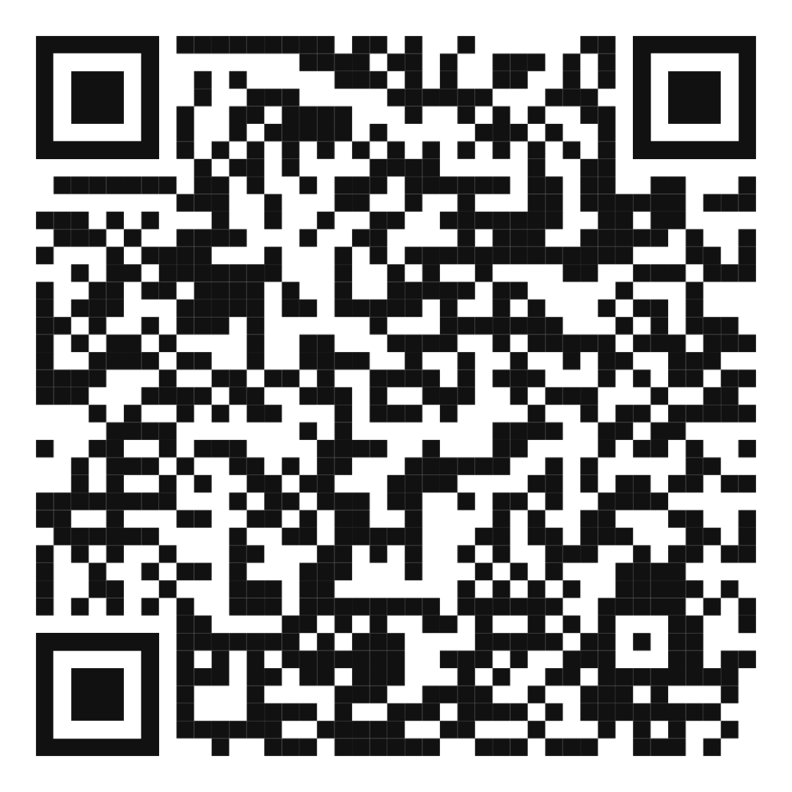
August 11th Training
The Conference Center at Wayne - Finger Lakes BOCES
9 AM - 12 PM
Local History and Culturally Responsive-Sustaining Education Professional Learning All teachers will experience an adapted version of the Antiracist Curriculum Project’s curriculum on Enslavement and Resistance in NYS and Redlining and Civil Rights in NYS Curriculum specifically tailored for their region.
1 PM - 3 PM
Interrupting Harmful Remarks at School Participants will explore and adapt the Learning for Justice Speak Up at School guide: how to respond when someone—a student, a colleague, even a parent—uses biased language or stereotypes in school.

Slide 16
Health and Wellness Updates

Slide 17
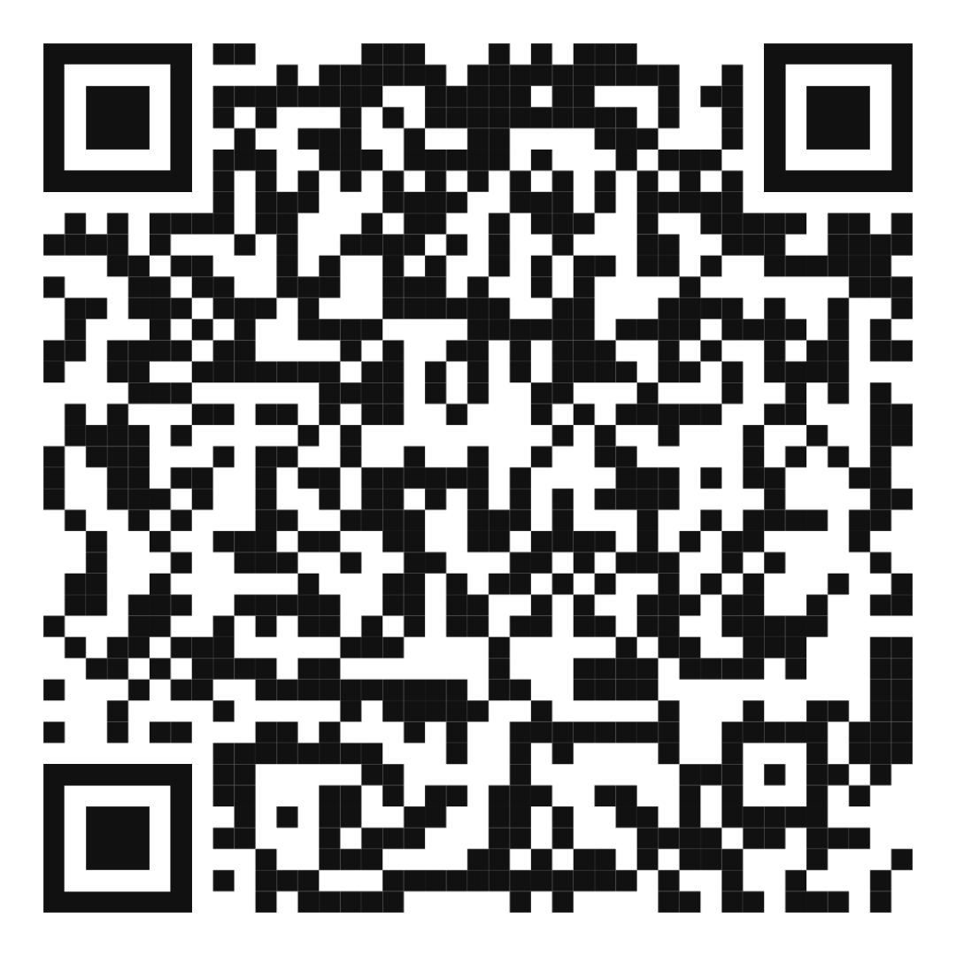
Bicentennial Youth Torch Relay
Learn more and register via the QR Code below.

Slide 18
211 Resource Mapping & MyWayfinder

Slide 19
ROOM ASSIGNMENTS
Pick a grade level
6th Grade— GALA
8th Grade EMPIRE
10th Grade – Diamond
12th Grade– Diamon

Slide 20
Data Discussion
If you could go back in time to one grade, would it be 6th, 8th, 10th, or 12th?
In your assigned cohorts, focus your discussion on solely your assigned grade level.
Can you list the developmental changes and fundamental youth development that typically occur between the grade levels surveyed?
Make predictions about what impact COVID-19 could have had on your assigned grade-level cohort.
What do you notice about risk factor percentages for each grade level from 2019-2023?
What do you notice about leading risk factors for 6th graders? 8th graders? 10th graders? 12th graders?
What questions do you have that we should ask youth at our next Youth Leadership Forum?
What urgencies are you feeling looking at this data?

Slide 21
Share Outs

Slide 22
Complete our Collaboration Survey by September 15th!
How well we work together makes a difference. It’s our ability to work together that helps us accomplish our goals and improve our community.
If something is important, then it should be measured and monitored. Help us see how we’re doing working with one another by completing this survey.

Slide 23
Upcoming Partnership Meetings
October 11th, 2023 Extended— 9 am to Noon This meeting will be joined by Kern County Visitors and the Coalition for Community Schools
January 10th, 2024, 9 AM- 10:30 AM Virtual
March 13th, 2024, 9 AM - 10:30 AM Wayne-Finger Lakes BOCES
May 8th, 2024, 9 AM - 10:30 AM Wayne-Finger Lakes BOCES

